Slide 1
Algorithmic Applications of High-Dimensional Geometry (1)
Alex Andoni

Slide 2
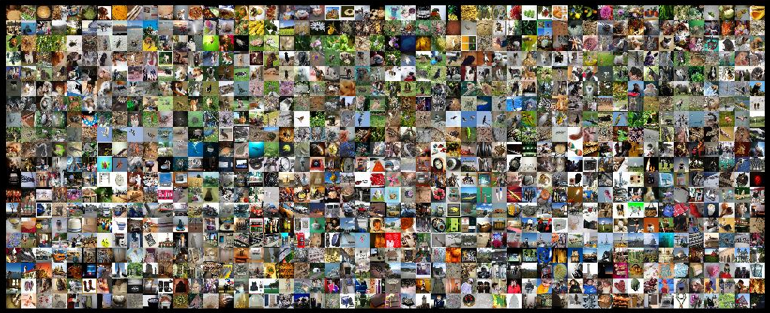
Find similar pairs

Slide 3
Algorithm Design
Happy when your algorithm is efficient
Golden standard: polynomial time
$O\left(n^{2}\right)$ time
CSOR 4231
Ask not what runtime is achievable for your problem,
but what you can solve in small runtime

Slide 4
Algorithm Design
Modern
eg space: working memory << all data
communication,…
New goal: linear (or less) time
resources
approximately
randomized
$$≈$$
Algorithm( )
$O\left(n\right)$ time
Ask not what runtime is achievable for your problem,
but what you can solve in small runtime

Slide 5
Methodology ?
Small space algorithms
Efficient representation
Classic algorithms: $n⋅2^{Ω(d)}$ time
Fast algorithms
000000
011100
010100
000100
010100
011111
dimension
reduction
000000
011100
010100
000100
010100
011111
compression
good for specific task
lossy
$$≈$$
000000
001100
000100
000100
110100
111111
000000
001100
000100
000100
110100
111111
$$≈$$
Dimension reduction: linear map $S:ℝ^{n}→ℝ^{k}$ s.t:
for any points $p,q∈ℝ^{n}$:
$\underset{S}{Pr}\left[\frac{||S\left(p\right)−S(q)||}{||p−q||}∈\left(1±ε\right)\right]≥1−δ$
[Johnson-Lindenstrauss’84]:
$S$ = Gaussian matrix
$$k=O\left(\frac{1}{ε^{2}}\log{\frac{1}{δ}}\right)$$

Slide 6
Plan
Dimension reduction
Application: Numerical Linear Algebra
Sketching
Application: Streaming
Space partitions:
Application: Nearest Neighbor Search
and more…

Slide 7
Dimension Reduction: Johnson-Lindenstrauss Lemma [JL84]
Preserves distances among $N$ points with probability at least $1−1/N$
by choosing $k=O\left(\frac{\log{N}}{ε^{2}}\right)$
Dimension reduction: linear map $S:ℝ^{n}→ℝ^{k}$ s.t:
for any points $p,q∈ℝ^{n}$:
$\underset{S}{Pr}\left[\frac{||S\left(p\right)−S(q)||}{||p−q||}∈\left(1±ε\right)\right]≥1−δ$
[Johnson-Lindenstrauss’84]:
take $S\left(x\right)=G⋅x$
$G$ a Gaussian matrix
then $δ=e^{−Θ\left(ε^{2}k\right)}$

Slide 8
Numerical Linear Algebra
$$A$$
$$x$$
$$b$$
$$−$$
Problem: Least Square Regression
$x^{∗}=argmin_{x}||Ax−b||$
where $A$ is $n×d$ matrix
$n≫d$
$1+ε$ approximation
Usual (exact) solution:
Perform SVD (singular value decomposition)
Takes $O\left(nd^{ω−1}\right)≈O(nd^{1.373})$ time
Faster?

Slide 9
Numerical Linear Algebra
$$A$$
$$x$$
$$b$$
$$S$$
$$−$$
$$S$$
Problem: Least Square Regression
$x^{∗}=argmin_{x}||Ax−b||$
Idea: Reduce-Dimension & Solve
$x^{′}=argmin_{x}||S⋅\left(Ax−b\right)||=argmin_{x}||SAx−Sb||$
where $S:ℝ^{n}→ℝ^{k}$ is a dimension-reducing matrix
New problem size: $k×d$
Hope: $||Ax^{′}−b||≈||Ax^{∗}−b||$
Dimension reduction $S$ satisfies:
$||S(Ax−b)||≈||Ax−b||$ with probability ${1−e}^{−Ω(ε^{2}k)}$ for any $x$
$$SA$$
$$x$$
$$Sb$$
$$−$$
Not good enough!
There’s an infinite number of $x$’s
Can happen that one of them has $||S\left(Ax−b\right)||≪||Ax^{∗}−b||$

Slide 10
NLA: Reduce-Dimension & Solve
[Sarlos’06, CW’13, NN’13, MM’13, C’16]
Enough now!
Need $||S(Ax−b)||≈||Ax−b||$ only for $P=\{Ax−b, x∈R^{d}\}$
Overall algorithm:
Compute $A^{′}=PHD⋅A$ and $b^{′}=PHD⋅b$
Solve $argmin_{x}||A′x−b′||$
New issue: time to compute $SA$
Takes $k×n×d>nd^{2}$ time
Idea: structured $S$ s.t. $SA$ can be computed faster (will see)
Eventually get: $O\left(nnz\left(A\right)+{\left(\frac{d}{ε}\right)}^{O\left(1\right)}\right)$ time
+Preconditioner: $O\left(\left(nnz\left(A\right)+d^{O\left(1\right)}\right)⋅\log{\frac{1}{ε}}\right)$
Oblivious Subspace Embedding: linear map $S:ℝ^{n}→ℝ^{k}$s.t.
for any linear subspace $P⊂ℝ^{n}$ of dimension $d$:
$\underset{S}{Pr}\left[∀p∈P :\frac{||S\left(p\right)||}{||p||}∈\left(1±ε\right)\right]≥1−δ$
$$k=O\left(\frac{d}{ε^{2}}\log{\frac{1}{δ}}\right)$$
$S$ = Gaussian matrix
slower than the original problem !

Slide 11
Structured Dimension Reduction
Dim-reduction so far: $S\left(y\right)=\frac{1}{\sqrt{k}}Gy$
where $G$ gaussian matrix
$O(nk)$ to compute
Faster ?
Ideally: $O\left(nnz\left(y\right)+k^{O\left(1\right)}\right)$
Will see: $O(n\log{n}+k^{3})$ time [Ailon-Chazelle’06]
$$n$$
$$G$$
$$y$$
$$k$$

Slide 12
Fast JL Transform
$$n$$
$$G$$
$$G$$
$$y$$
$z=S\left(y\right)=Gy$
Costly because $G$ is dense
Meta-approach: use $sparse$matrix $G$ ?
Suppose sample $s$ entries per row
Analysis of one row:
$h:\left[n\right]→\{0,1\}$ s.t. $h(i)=1$ with probability $s/n$
$z_{1}=η⋅$ $\sum_{i=1}^{d}{h(i)}⋅g_{i}y_{i}$
Expectation of $z_{1}^{2}$:
$E\left[z_{1}^{2}\right]=η^{2} E\left[\sum_{i}{h\left(i\right)g_{i}^{2} y_{i}^{2}}\right]=η^{2}⋅\frac{s}{n}⋅{\left|\left|y\right|\right|}^{2}$
What about concentration?
$$k$$
Set $η=\sqrt{n/s}$
normalization constant

Slide 13
Fast JLT: sparse projection
$$n$$
$z_{1}$ doesn’t concentrate ☹
Bad case: $y$ is sparse
think: $y=e_{1}−e_{2}$
Even for $s≈n/k$ (each coordinate of $y$ goes somewhere)
two coordinates collide (bad) with probability ~$1/k$
want exponential in $k$ failure probability
really would need $s≈n$
But, take away: may work if $y$ is “spread around”
New plan:
“spread around” $y$
then use sparse $G$
$$G$$
$$y$$
$$k$$

Slide 14
FJLT: construction
Idea: rotate $y$ to make it dense!
$P$ = projection matrix:
sparse matrix as before, with size $k^{′}×n$, with $k^{′}≈k^{2}$ (ie, a little worse)
$H$= Hadamard matrix (Fourier transform)
Uncertainty principle: if the original $y$ is sparse, then the transform is dense!
$Hy$ can be computed in time $O(n⋅log n)$ -- Fast Fourier Transform
What about $y$ s.t. $Hy$is sparse?
$D$ = matrix with random $±1$ on diagonal
$$S\left(y\right)=PHD⋅y$$
“spreading around”
Projection:
sparse matrix
Hadamard
(Fourier Transform)
Diagonal

Slide 15
Beyond $ℓ_{2}$: other norms/distances?
E.g., $ℓ_{1}$ regression?
Dimension reduction a-la JL?
Essentially no [CS’02, BC’03, LN’04, JN’10…]
For $N$ points, $D$ approximation: dimension between $N^{Ω\left(1/D^{2}\right)}$ and $O(N/D)$ [BC03, NR10, ANN10…]
In contrast to $ℓ_{2}$: [JL] gives $O\left(ε^{−2}\log{N}\right)$ (and is oblivious)
New approach:
Generalize the notion of dimension reduction!

Slide 16
Computational view
$$M$$
$$x$$
$$y$$
$${\left\{0,1\right\}}^{k}$$
$${\left\{0,1\right\}}^{k}×{\left\{0,1\right\}}^{k}→ℝ$$
$S:Mℝ^{k}$
Arbitrary target “space” $C:ℝk×ℝkℝ_{+}$
Cons:
Less geometric structure (e.g., $C$ not metric)
Pros:
More expressability: better trade-off
approximation vs “dimension” $k$
Sketch $S$: “functional compression scheme”
for estimating distances
almost all lossy ($1+ε$ distortion or more) and randomized
$$S$$
$$S(x)$$
$$S(y)$$
$$d_{M}(x,y)≈\sqrt{\sum_{i=1}^{k}{{(S_{i}(x)−S_{i}(y))}^{2}}}$$
$$C(S\left(x\right), S\left(y\right))$$

Slide 17
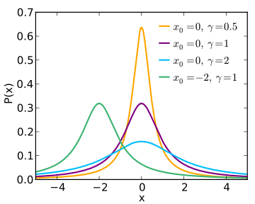
Sketching for $ℓ_{1}$
Analog of Euclidean projections ?
For $ℓ_{2}$, we use: Gaussian distribution
has stability property:
$g_{1}z_{1}+g_{2}z_{2}+…g_{d}z_{d}$ is distributed as $g⋅||z||$
Is there something similar for 1-norm?
Yes: Cauchy distribution!
1-stable:
$c_{1}z_{1}+c_{2}z_{2}+…c_{d}z_{d}$ is distributed as $c⋅||z||_{1}$
What’s wrong then?
Cauchy are heavy-tailed…
doesn’t even have finite expectation (of abs)
$$pdf\left(s\right)=\frac{1}{π(s^{2}+1)}$$

Slide 18
Sketching for $ℓ_{1}$ [Indyk’00]
Still, can consider similar random map
$S\left(x\right)=Cx=\left(C_{1}x, C_{2}x, …,C_{k}x\right)$
Consider $S\left(x\right)−S\left(y\right)=Cx−Cy=C\left(x−y\right)=Cz$
where $z=x−y$
each coordinate distributed as $||z||_{1}×$Cauchy
Take 1-norm: $||Cz||_{1}$ ?
does not have finite expectation, but…
Can estimate $||z||_{1}$ by:
median$\left(\left|C_{1}z\right|, \left|C_{2}z\right|,…\left|C_{k}z\right|\right)$
Main correctness claim: for each $i$
$Pr\left[\left|C_{i}z\right|>||z||_{1}⋅(1−ε)\right]>1/2+Ω(ε)$
$Pr\left[\left|C_{i}z\right|<||z||_{1}⋅(1+ε)\right]>1/2+Ω(ε)$

Slide 19
Estimator for $ℓ_{1}$
Estimator: median$\left(\left|C_{1}z\right|, \left|C_{2}z\right|,…\left|C_{k}z\right|\right)$
Correctness claim: for each $i$
$Pr\left[\left|C_{i}z\right|>||z||_{1}⋅(1−ε)\right]>1/2+Ω(ε)$
$Pr\left[\left|C_{i}z\right|<||z||_{1}⋅(1+ε)\right]>1/2+Ω(ε)$
Proof:
$\left|C_{i}z\right|$ is distributed as $abs\left(||z||_{1}c\right)=||z||_{1}⋅|c|$
Hence claim equivalent to
$\operatorname{Pr}\left[\left|c\right|>\left(1−ε\right)\right]>1/2+Ω\left(ε\right)$
$\operatorname{Pr}\left[\left|c\right|<\left(1+ε\right)\right]>1/2+Ω\left(ε\right)$
Matter of checking the pdf of the Cauchy vars…

Slide 20
Estimator for $ℓ_{1}$: high probability bnd
Estimator: median$\left(\left|C_{1}z\right|, \left|C_{2}z\right|,…\left|C_{k}z\right|\right)$
Claim: for each $i$
$Pr\left[\left|C_{i}z\right|>||z||_{1}⋅(1−ε)\right]>1/2+Ω(ε)$
$Pr\left[\left|C_{i}z\right|<||z||_{1}⋅(1+ε)\right]>1/2+Ω(ε)$
Take $k=O\left(\frac{1}{ε^{2}}\log{\frac{1}{δ}}\right)$
$E\left[\sum_{i}{L_{i}}\right]≥k(1/2+Ω\left(ε\right))$
Hence $\operatorname{Pr}\left[\sum_{i}{L_{i}}≤\frac{k}{2}\right]<δ$ (CLT: Chernoff bound)
Similarly with $U_{i}$
The above means that
median$\left(\left|C_{1}z\right|, \left|C_{2}z\right|,…\left|C_{k}z\right|\right)∈\left(1±ε\right)||z||_{1}$
with probability at most $2δ$
$$L_{i}=1$$
if holds
$$U_{i}=1$$
if holds

Slide 21
$ℓ_{1}$ regression
+structured $S$, +preconditioner: $O\left(nnz\left(A\right)⋅\log{n}+{\left(\frac{d}{ε}\right)}^{O\left(1\right)}\right)$
Much more: other norms ($ℓ_{p}$, M-estimator, Orlicz norms), low-rank approximation & optimization, matrix multiplication, see [Woodruff, FnTTCS’14,…]
Weak DR: linear map $S:ℝ^{n}→ℝ^{k}$, s.t.
for any $p∈ℝ^{n}$: $\underset{S}{Pr}\left[1≤\frac{||S\left(p\right)||_{1}}{||p||_{1}}≤\frac{1}{δ}\right]≥1−O(δ)$
$S_{ij}∼$ Cauchy distribution, or $1$/Exponential
[I’00]
[SW’11, MM’13, WZ’13, WW’18]
Weak(er) OSE: linear map $S:ℝ^{n}→ℝ^{k}$s.t.
for any linear subspace $P⊂ℝ^{n}$of dimension $d$: $\underset{S}{Pr}\left[∀p∈P :1≤\frac{||S\left(p\right)||_{1}}{||p||_{1}}≤d^{O\left(1\right)}\right]≥0.9$
$$k=O(d⋅log d)$$

